Slide 1

AI Agents in Excel and Copilot Studio
George Mount
Stringfest Analytics

Slide 2
Objectives For Today
Integrate and execute Agent Mode in Excel to build analytical and reporting tools and workflows.
Design and deploy lightweight agents in Copilot Studio to perform repetitive data analysis tasks.
Demonstrate how agentic AI can extend across Microsoft 365 tools such as Power BI and Teams.
Apply best practices for guiding and supervising AI agents to ensure data accuracy and compliance.

Slide 3
Schedule For Today
Module 1: Agent Mode and Pre-Built Agents
Module 2: Build an Excel Chatbot in Copilot Studio
Module 3: Building and Deploying an Automated AI Workflow

Slide 4

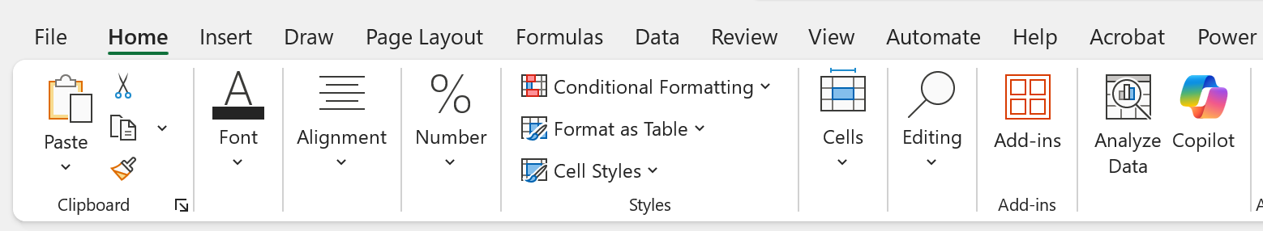
Pulse Check
Do you have access to Copilot in Excel?
Home > Copilot

Slide 5
Pulse Check
Do you have access to Agent Mode in Excel Online?
Available via the Frontier program

Slide 6
Pulse Check
Do you have access to Copilot Studio?
Free trial available: https://learn.microsoft.com/en-us/microsoft-copilot-studio/requirements-licensing-subscriptions

Slide 7
I. Agent Mode and Pre-Built Agents
What Excel features does Python in Excel depend on?
Formulas
PivotTables
Power Query
Copilot
Data Remember when Excel got…
Now it’s getting Agents!

Slide 8
Exercise
Using the Researcher & Analyst agents in Excel
Dataset: researcher-analyst.xlsx
Researcher helps you understand the broader context around your data.
Analyst performs calculations and generates insights directly from your tables.
Together they show Excel’s shift from simple prompts to agent-driven reasoning.
Notes:
The key to #2 is using “Unpivot All” in Power Query. If you're not sure how to do this, feel free to skip it and just load the data into Excel for now. But take this as a sign—it might be worth brushing up a bit on Power Query before diving deeper into Python in Excel!

Slide 9
What does Microsoft mean by “agent?”
An agent is an AI system that can understand goals, reason about steps, and take actions to complete a task.
Goes beyond Q&A → performs multi-step workflows driven by user intent.
Uses memory, tools, and environment signals to stay on track.
Designed to be autonomous but bounded (rules, safety, context).
Notes:
Could help you create charts or summaries quickly, or maybe it could even help you take your analysis one level deeper with predictive analytics, unstructured data or charts that are otherwise difficult to build in Excel

Slide 10
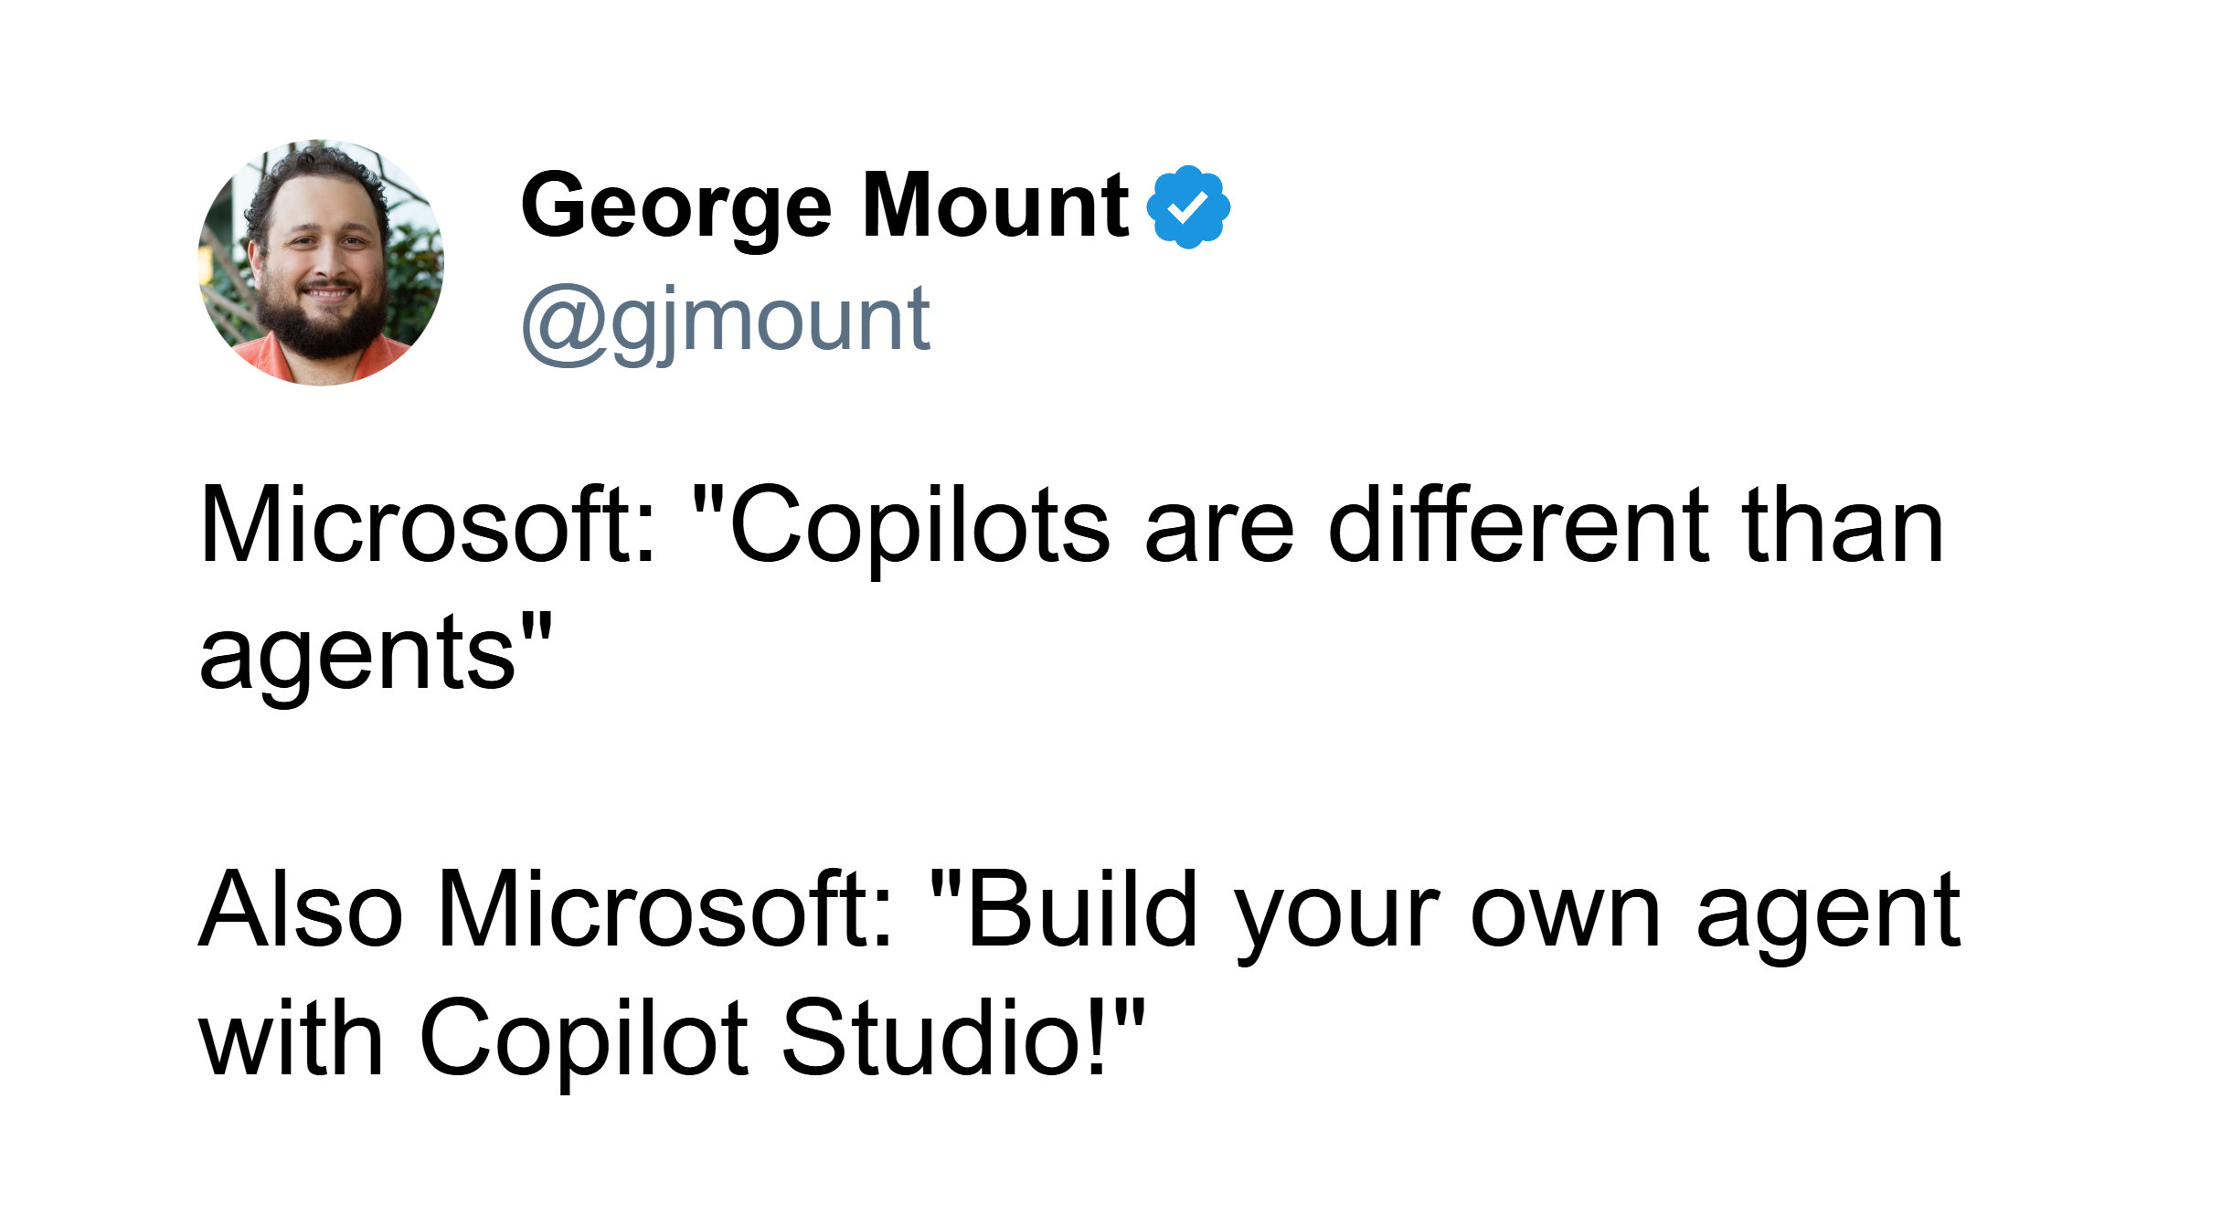
The lines are sometimes not so clear…
Notes:
Could help you create charts or summaries quickly, or maybe it could even help you take your analysis one level deeper with predictive analytics, unstructured data or charts that are otherwise difficult to build in Excel

Slide 11
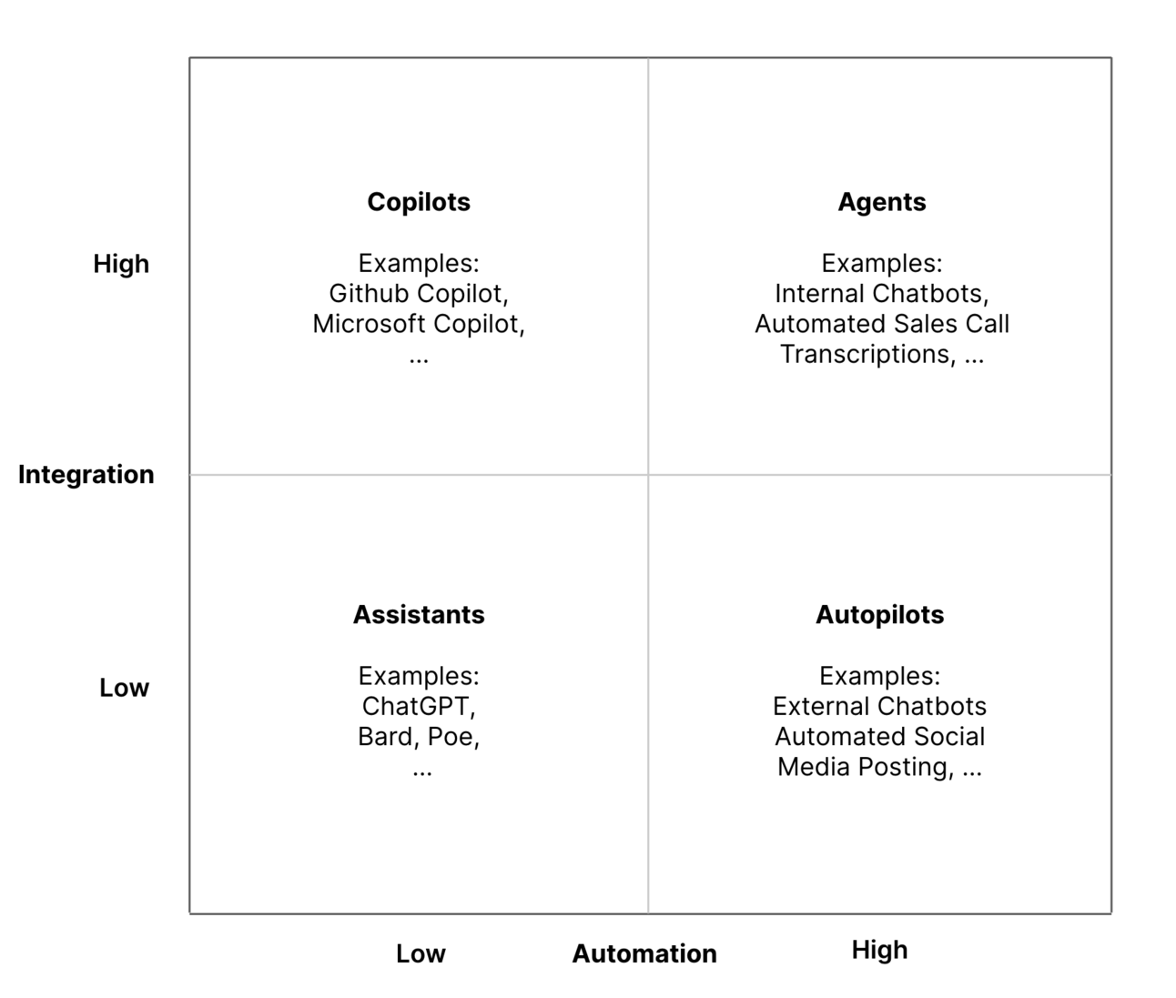
The integration-automation AI framework
Source: https://blog.tobiaszwingmann.com/p/integration-automation-ai-framework
Notes:
Could help you create charts or summaries quickly, or maybe it could even help you take your analysis one level deeper with predictive analytics, unstructured data or charts that are otherwise difficult to build in Excel

Slide 12
The integration-automation AI framework
Source: https://blog.tobiaszwingmann.com/p/integration-automation-ai-framework
Notes:
Could help you create charts or summaries quickly, or maybe it could even help you take your analysis one level deeper with predictive analytics, unstructured data or charts that are otherwise difficult to build in Excel

Slide 13
Discussion
Have you tried Copilot in Excel? What have you liked and disliked about it?
Where could Excel benefit you further with agentic assistance?
Notes:
Could help you create charts or summaries quickly, or maybe it could even help you take your analysis one level deeper with predictive analytics, unstructured data or charts that are otherwise difficult to build in Excel

Slide 14
Exercise
Import & transform Wholesale Customers for Python in Excel
Dataset: agent-mode.xlsx
Use cases:
Loan calculator
Variance analysis
Monthly close pack
What does Agent Mode do well, poorly, or not at all?
How does this relate to other tools in the Excel AI stack?
Notes:
The key to #2 is using “Unpivot All” in Power Query. If you're not sure how to do this, feel free to skip it and just load the data into Excel for now. But take this as a sign—it might be worth brushing up a bit on Power Query before diving deeper into Python in Excel!

Slide 15
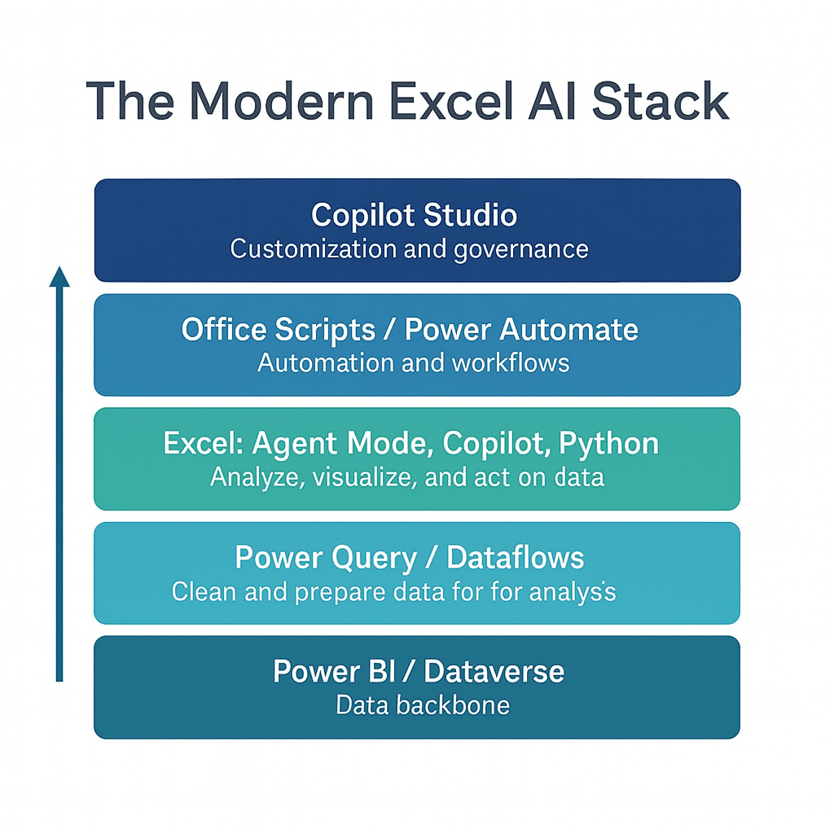
Understanding the Modern Excel AI stack
Notes:
Could help you create charts or summaries quickly, or maybe it could even help you take your analysis one level deeper with predictive analytics, unstructured data or charts that are otherwise difficult to build in Excel

Slide 16
II. Introduction to Copilot in Excel
Getting started with Advanced Analysis
Loading dataset into “Advanced Analysis”
Conducting a guided step-by-step analysis with Python and Copilot
Diving deeper by questoning Copilot’s reasoning and asking for follow-up explanations and support
Demo file: ai-powered-python-excel-getting-started.xlsx

Slide 17
Discussion Question
Identify a data analytics task that you believe could be automated or assisted using Copilot. How could this change your workflow?
Notes:
Could help you create charts or summaries quickly, or maybe it could even help you take your analysis one level deeper with predictive analytics, unstructured data or charts that are otherwise difficult to build in Excel

Slide 18
Questions?
Notes:
You will be able to see questions as they come in. Some instructors like to include this slide as a visual reminder to check the Q&A widget, but it’s not required.

Slide 19
Break
Notes:
Breaks are flexible in On24. At the end of your deck you’ll have 5 minute, 7 minute, 10 minute, and 15 minute timers that you will be able to push to the audience whenever you want. Some presenters like to include this break slide as a visual reminder, but it’s not required.

Slide 20
II. Build an Excel chatbot in Copilot Studio
Create a custom Copilot agent in Copilot Studio tailored for specific Excel-related use cases
Add and manage trusted knowledge sources (like MVP websites) to ensure high-quality, domain-specific responses
Test and publish the agent with simple topics added
File: mvp-knowledge-base-instructions.docx

Slide 21
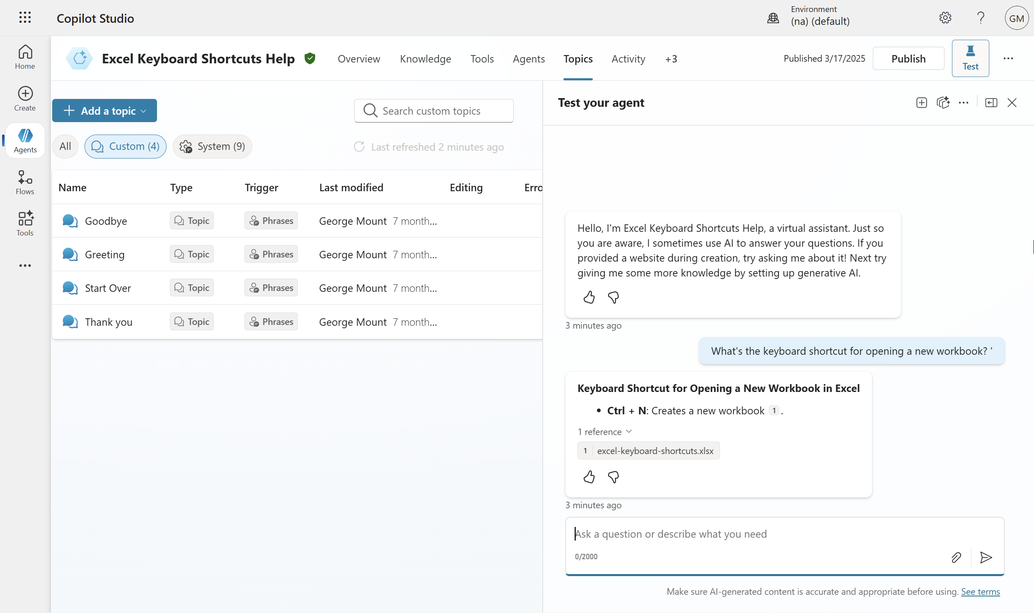
Exercise
Create an Excel keyboard shortcut chatbot for Teams
Folder: copilot-studio-exercise
Create a chatbot that helps users find Excel keyboard shortcuts, using only the provided “Excel keyboard shortcuts” cheat sheet as its knowledge base
Edit the “goodbye” topic to replace the default response (“okay, goodbye”) with a more engaging sign-off like “Keep on excelling,” then save and test
Publish the chatbot and launch it in Microsoft Teams to see it running inside an external app
Notes:
The key to #2 is using “Unpivot All” in Power Query. If you're not sure how to do this, feel free to skip it and just load the data into Excel for now. But take this as a sign—it might be worth brushing up a bit on Power Query before diving deeper into Python in Excel!

Slide 22
Questions?
Notes:
You will be able to see questions as they come in. Some instructors like to include this slide as a visual reminder to check the Q&A widget, but it’s not required.

Slide 23
Break
Notes:
Breaks are flexible in On24. At the end of your deck you’ll have 5 minute, 7 minute, 10 minute, and 15 minute timers that you will be able to push to the audience whenever you want. Some presenters like to include this break slide as a visual reminder, but it’s not required.

Slide 24
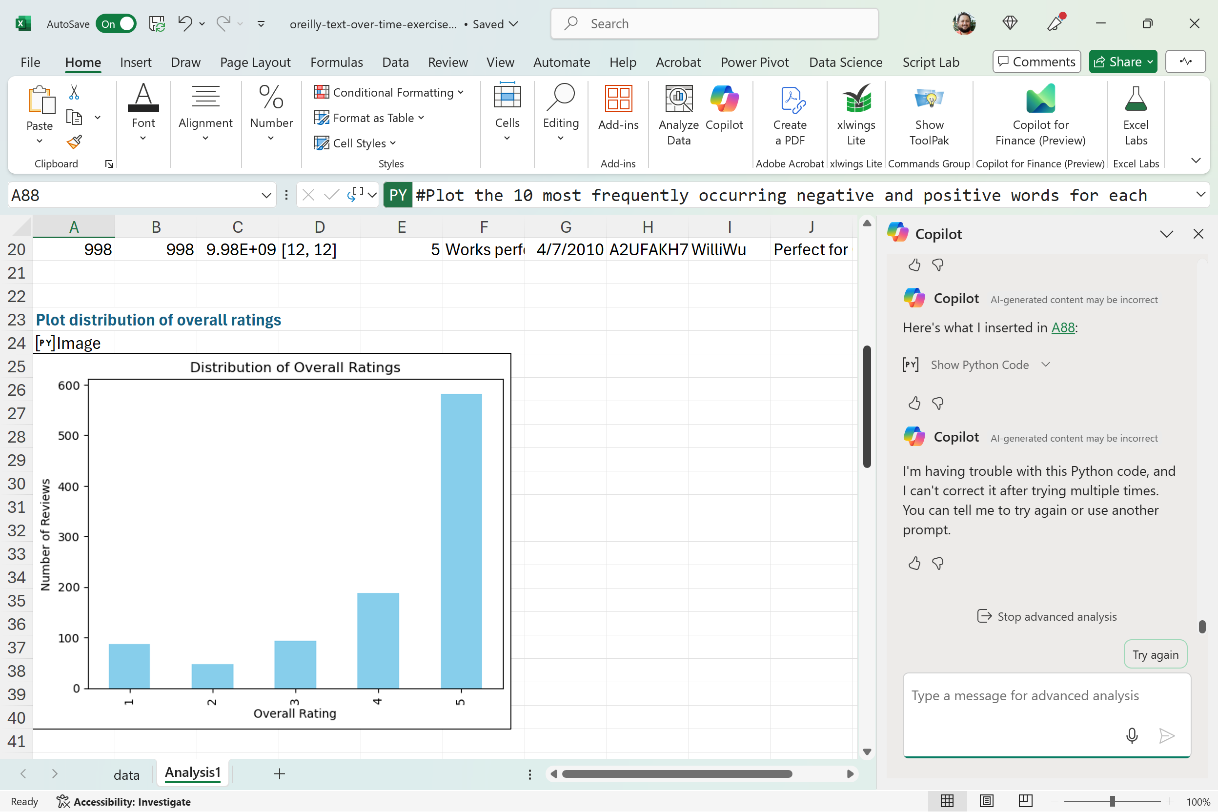
III. Building and deploying an AI-powered workflow
Tracking customer reviews over time
Dataset: copilot-text-time-series-exercise.xlsx
Analyze customer reviews across different time periods using this dataset
Use Copilot to visualize the top positive and negative sentiment words for each quarter
Ask Copilot to explain the strengths and limitations of this type of sentiment analysis.

Slide 25
Questions?
Notes:
You will be able to see questions as they come in. Some instructors like to include this slide as a visual reminder to check the Q&A widget, but it’s not required.

Slide 26
V. Wrap-up and Q&A
Techniques for validating and cross-checking AI-generated insights in Excel
Key takeaways and lessons from today's session
Recommended resources & next steps

Slide 27
Key Takeaways For Today
AI-powered Python in Excel is designed for experienced users, not beginners
Human analysts remain essential for oversight and interpretation
How could this shift reshape the future of data analytics?
Is this the beginning of the end for dashboard-centric “self-service BI”?
The rise of augmented analytics and the “citizen data scientist”

Slide 28

Cross-checking AI-powered Excel
What processes can we follow to safeguard and cross-check our Python-Copilot-Excel workflow?
Resource: https://stringfestanalytics.com/how-to-cross-check-ai-generated-insights-in-excel/
“Treat AI like an intern”

Slide 29
Recommended Resources
Available on O’Reilly Online Learning:
Read Microsoft Copilot Studio Quick Start
Read Learning Generative AI Tools for Excel
Take “Copilot in Microsoft 365: A Practical Introduction to Working with Generative AI in Microsoft 365”

Slide 30
Takeaways
Get in touch
stringfestanalytics.com: Subscribe for more content and updates
Check ai-powered-python-in-excel-resources.docx in your resource folder for a series of curated posts on this topic
linkedin.com/in/gjmount: Follow for all things analytics in modern Excel

Slide 31
Takeaways
Next steps
A quick survey will appear on your screen soon… we’d love to hear your thoughts
You’ll receive a recording via email within 24-48 hours.
Thanks so much for joining -- hope to see you at future events!

Slide 32
Q&A
Notes:
You will be able to see questions as they come in. Some instructors like to include this slide as a visual reminder to check the Q&A widget, but it’s not required.

Slide 33


Slide 34
Poll: What will you ask attendees?
Polls are a great way to check in with attendees! You can ask them about their opinions, experience level, or quiz their knowledge. We find that 1-3 poll questions per hour is best.
Poll answer 1
Poll answer 2
Poll answer 3

Slide 35
Discussion Question
What should attendees think about? Ask a prompt question that attendees can answer in the group chat.

